Slide 1

UNIX Introduction
Peter Wad Sackett

Slide 2
History of UNIX
Emerged in 1971 from a more complex system (which failed).
Lead designers: Ken Thompson & Dennis Ritchie
Generally used in the public and private sector.
Linux emerged in 1991 by effort of Linus Torvalds.
Many different UNIX versions exists.
By now, Linux is the main UNIX platform. Reason; free and good.
But does the history of UNIX matter !
Not really, except from the effect it has had on Open Source.
A set of enabling technologies first developed at AT&T that have been incorporated into several legally distinct but closely related operating systems, each of which can be considered to be a "UNIX system." If it looks like UNIX, operates like UNIX, runs common UNIX utilities and programs, and is developed with UNIX as a model, it's UNIX. Seth T. Ross

Slide 3
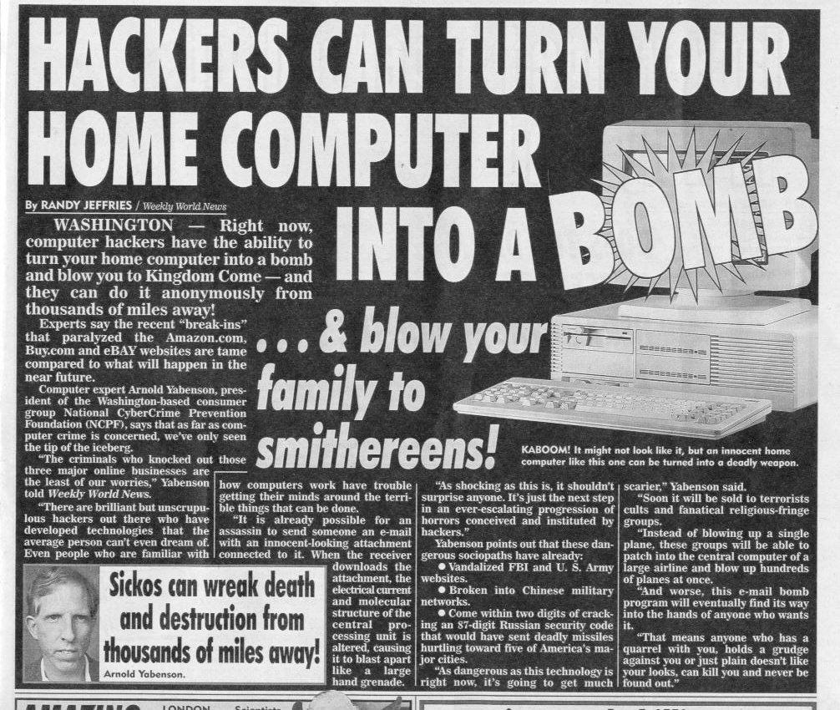
Reasons to learn UNIX

Slide 4
Better reasons
Automation
Stability
Development
Large tool set
Free(dom)
Mastery of UNIX, like mastery of language, offers real freedom. The price of freedom is always dear, but there’s no substitute. Personally, I’d rather pay for my freedom than live in a bitmapped, pop-up-happy dungeon like Windows. I’m hoping that as IT folks become more seasoned and less impressed by superficial convenience at the expense of real freedom, they will yearn for the kind of freedom and responsibility UNIX allows. When they do, UNIX will be there to fill the need. Thomas Scoville

Slide 5
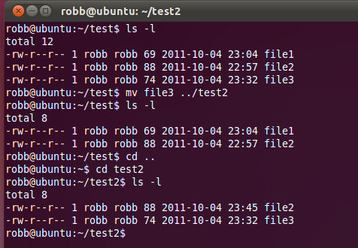
Get to it; The Shell
Command line interface
Everything has to be typed
File system navigation
Many simple tools available
Tab completion
Repeating commands
Copy/Paste

Slide 6
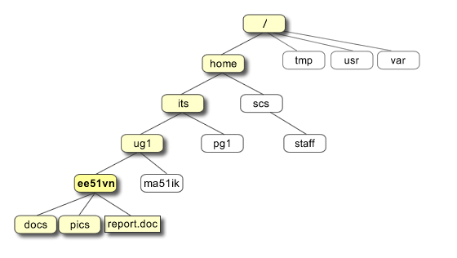
File system navigation
Listing files
ls
ls –l
The path
Changing directories
cd <folder>
Creating directories
mkdir <folder>
Deleting directories
rmdir <folder>
Where are you?
pwd
Why are you here?
Sorry, no answer to that one

Slide 7
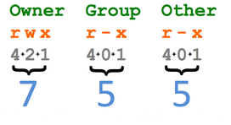
File handling
Coping files
cp <file> <destination>
Moving/renaming files
mv <file> <destination>
Deleting files
rm <file>
Changing file permissions.
chmod <options> <file>

Slide 8
File inspection
Seeing the top of the file
head <file>
Seeing the end of the file
tail <file>
Seeing all of the file
cat <file>
Inspecting the file
less <file>
You can browse up and down in the file with PgUp/b and PgDn/space, search with /, but most importantly exit the application with q. G goes to the top and g to the bottom.

Slide 9
Editors
Grahpical editors (using X)
nedit <file>
gedit <file>
Pro: easy to use. Con: requires good bandwidth on the network
Also jEdit, Kwrite, TextWrangler (mac).
Text based editors
vim <file>
emacs <file>
Also vi, Elvis, jove, ed.
Pro: works fine on poor network. Con: hard to learn

Slide 10
Working with the file
Counting the lines/words/bytes in the file
wc <file>
Merging files
paste <file1> <file2>
Extracting columns from a file
cut <options> <file>
Usually used as ’cut –f2,4 myfile.txt’ on tab files
Sorting files
Sort <file>
Extracting lines from a file
grep <pattern> <file>
This is an incredibly useful command, very versatile.

Slide 11
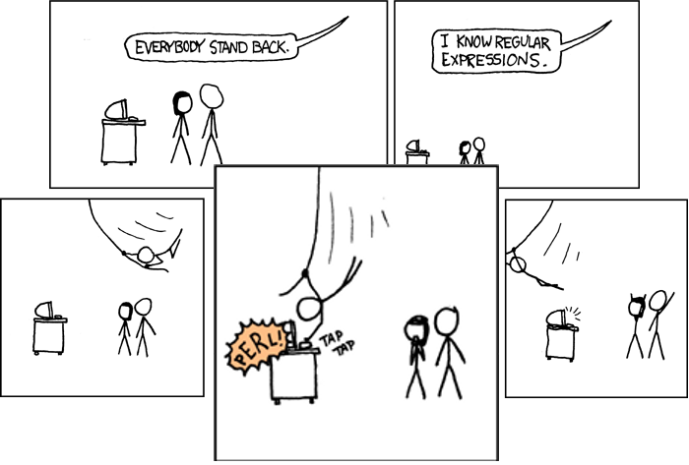
A closer look at grep and patterns
Many versions of grep – different capabilities
grep HUMAN <file> Lines containing HUMAN, like POSTHUMAN
grep –v HUMAN Lines without HUMAN
grep –c HUMAN Count lines with HUMAN
grep ”^HUMAN” Lines starting with HUMAN
grep ”HUMAN$” Lines ending with HUMAN
grep –e/E
Regular expressions
. any single char
+ one or more of preceeding char
* zero or more of preceeding char
grep –e ”H.+MAN” Matches HEMAN, HUMAN, HITMAN, etc

Slide 12
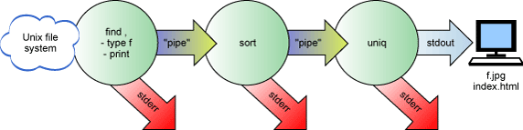
IO redirection and pipes
Every program has STDIN, STDOUT and STDERR
They are file streams – streams/lines of data.
Defaults; STDIN = keyboard, STDOUT, STDERR = screen
Save output of a command in a file; >
grep HUMAN orphans.sp > humanproteins.txt
Append to the file with >>
Feed a file to a command; <
wc < humanproteins.txt
Pipe (stream) the output of one command to the next command; |
grep HUMAN orphans.sp | wc
The pipe sign does not separate the commands, it connects them.

Slide 13
Miscellaneous
Downloading files from the internet
wget <URL>
An URL is the link you see in the browser.
Printing text to the screen
echo <text>
Getting time and date information
date
Seeing what programs are running
ps
Stopping them
kill <pid>

Slide 14
Remote computers
Logging in to remote computers.
ssh -X <username>@<hostname>
This will start a shell on the remote computer if you have an account on the machine.
Transferring files to and from other computers.
ftp <hostname>
Give your username and password to the remote computer. You
use the keywords "put” and "get" for file transfer.
An encrypted and therefore secure alternative is sftp.
sftp <username>@<hostname>
You will be prompted for password, but the functionality of ftp and sftp is the same.

Slide 15

More information and help
The UNIX manual
man <command>
The manual is shown with less. Also try google: man <command>
whatis <command>
Single line description of the command
Plenty of UNIX guides on the net. Here are some of the best.
http://www.ee.surrey.ac.uk/Teaching/Unix/
http://unixhelp.ed.ac.uk/
Google is your friend.

